Slide 1
Final Year Project Presentation

Slide 2
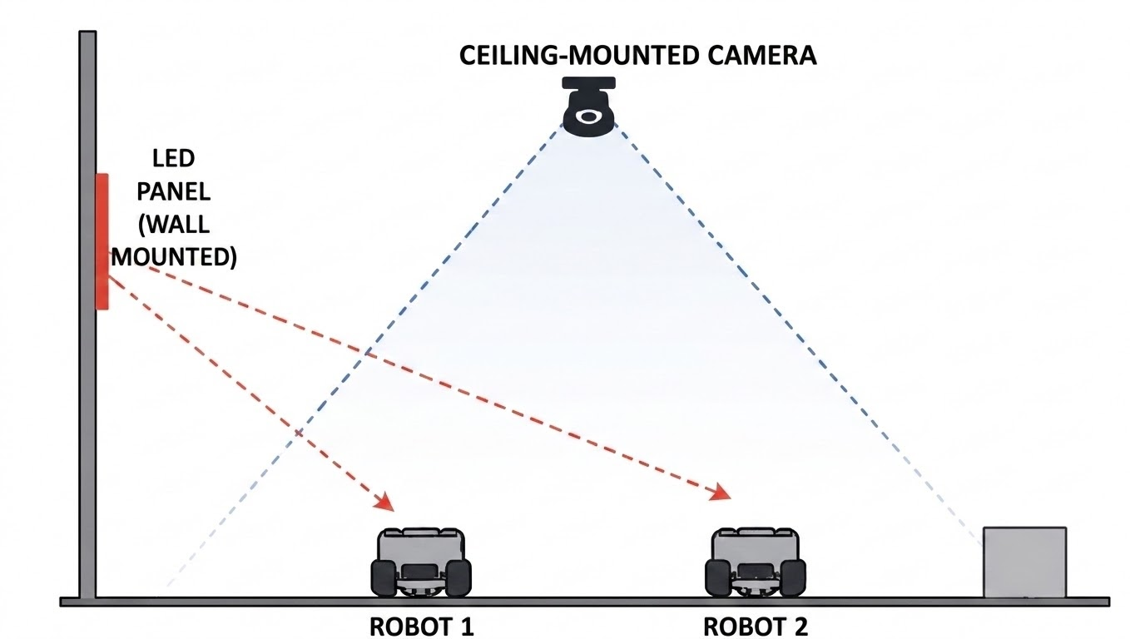
Project Introduction
Navigation with Enhanced Perception in Multi-Agent Systems through Camera-Based Visible Light Communications
A wall-mounted light source is used to send control commands to a robot through visible light signals, while an overhead camera provides a global view of the environment.
The system focuses on understanding robot position, movement, and surroundings to enable coordinated and safe navigation in an indoor space.

Slide 3
Key Functional
Concepts
Light-based communication used for sending commands from controller to robot
Overhead camera provides global view of robot and environment
Robot position and direction are continuously estimated from visual input
Environment is structured into a mapped coordinate system for navigation
Central controller makes movement decisions based on real-time perception
Robot can adjust actions based on local conditions for safety
Robot-to-robot communication is enabled using a secondary channel (e.g., LoRa) for coordination and information sharing

Slide 4
Project analysis slide 2
System Overview
The LED panel is placed on the wall near the working area in a small-scale setup. It acts as a Li-Fi transmitter that sends signals using visible light.
The robots receive these signals using light sensors and simple signal processing circuits.
A central LED panel acting as a Li-Fi access point for sending control commands.
Two mobile robots with sensors and optical communication units.
SYSTEM
Overhead camera-based system used for tracking and control.
Robots' inter-communication with each other using LoRa.

Slide 5
Applications
RF-Restricted Environments: Hospitals, aircraft cabins, or sensitive industrial areas.
Smart Indoor Robotics: Coordinated robot navigation for warehouses or labs.
Secure Communication Systems: Data transfer with minimal interference risk.
Educational & Research Platforms: Demonstrates Li-Fi and multi-robot coordination.
Prototype for IoT-Integrated Automation: Shows potential for smart building applications.

Slide 6
Role Allocation
Member 1 – Communication & Li-Fi Hardware
Focus: Establishing a reliable data link between the wall panel and the robot.
Primary Responsibility: Building the Li-Fi system to ensure the robot receives commands without errors.
Key Tasks:
Hardware Setup: Designing the wall-mounted LED transmitter and the robot-mounted light receiver.
Signal Quality: Filtering out ambient light to maintain a clean, consistent data stream.
Reliability Testing: Verifying the communication range and testing performance to ensure no data is lost during robot movement.
Goal: Create a "digital bridge" where the wall panel can reliably "talk" to the robot.

Slide 7
Role Allocation
Member 2 –Embedded Control & Robot Navigation
Focus: Enabling the robot to interpret instructions and move safely.
Primary Responsibility: Managing the robot's physical movement and ensuring it follows the commands received via Li-Fi.
Key Tasks:
Control Systems: Developing the robot's "onboard brain" (firmware) to interpret data into motor movements.
Movement Precision: Ensuring the robot navigates smoothly and accurately.
Safety & Obstacles: Implementing an automatic "safety override" system so the robot stops immediately if an obstacle is detected, regardless of the incoming command.
Goal: Build a robust, responsive, and safe robot that executes instructions effectively.

Slide 8
Role Allocation
Member 3 –
Focus: Managing the "Big Picture" view and directing overall system logic.
Primary Responsibility: Acting as the central controller to monitor the environment and coordinate robot decisions.
Key Tasks:
Vision System: Using the ceiling camera to track the robot's real-time position and orientation.
Strategic Planning: Calculating the most efficient paths for the robot to reach its destination.
Decision Making: Implementing a prioritization system to manage tasks, goals, and any potential conflicts between multiple robots.
Goal: Provide the "global intelligence" that tells the robots where to go and why.

Slide 9
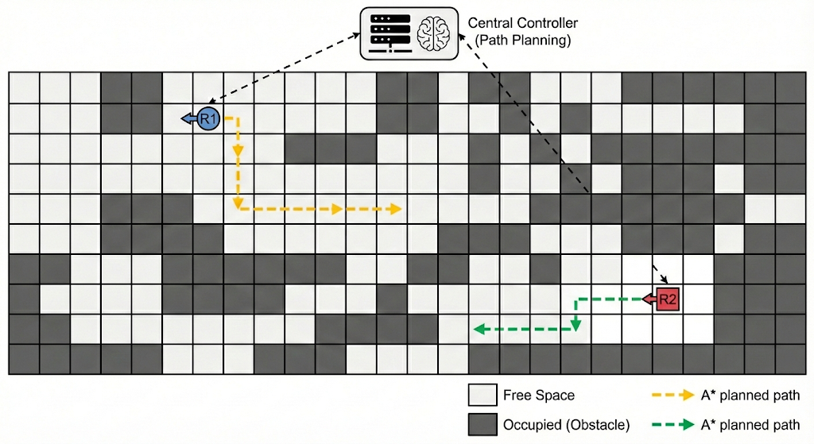
Centralized
Intelligence and Mapping
1. Decision-Making Strategy
A rule-based fallback system is always included. If the AI decision system fails or is uncertain, the system switches to a safe rule-based mode.
Obstacle avoidance logic
Goal-directed navigation
AI-based decision making for selecting actions based on distance, importance, and risk
This allows the system to make smarter and more flexible decisions instead of only fixed rules.

Slide 10
Centralized
Intelligence and Mapping
2. Backup Logic
A rule-based fallback system is always included.
If the AI decision system fails or is uncertain, the system switches to a safe rule-based mode. Hence the system works in two layers:
AI mode → primary decision making
Rule-based mode → Safety backup for reliable operation
This ensures the robots always behave safely even under unexpected conditions.

Slide 11
Thank You

